Slide 1
Use of Op-Amp as Comparator
Figure 17.3a shows a circuit operating with a positive reference voltage connected to the minus input and the output connected to an indicator LED.
The reference voltage level is set at Since the reference voltage is connected to the inverting input, the output will switch to its positive saturation level when the input, Vi, goes more positive than the 6-V reference voltage level.
The output, Vo, then drives the LED ON as an indication that the input is more positive than the reference level.
in Fig. 17.3b shows As an alternative connection, the positive reference voltage could be connected to the noninverting input and input voltage will connected to inverting input for omp-amplifier that the output will switch to its positive saturation level when the input, Vi, goes less than the 6-V reference voltage level.

Slide 2
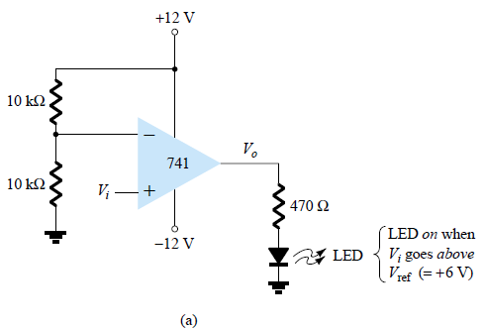
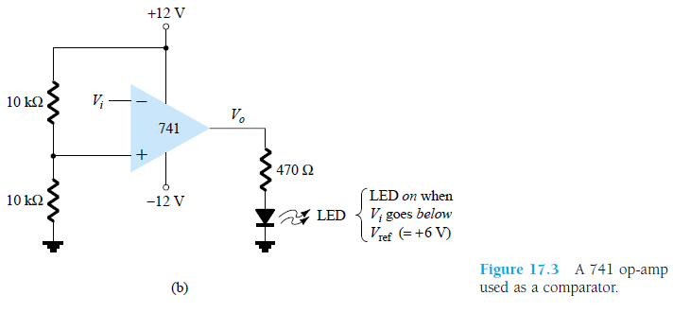

Slide 3
311 COMPARATOR
Page 723

Slide 4
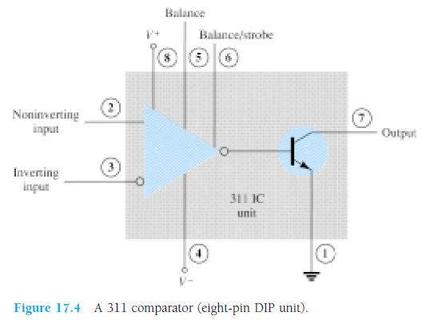
311 voltage comparator shown in Fig. 17.4 contains a comparator circuit that can operate as well from dual power supplies of 15 V as from a single 5-V supply.
The output can provide a voltage at one of two distinct levels or can be used to drive a lamp or a relay.
The output is taken from a bipolar transistor to allow driving a variety of loads.

Slide 5
A zero-crossing detector that senses (detects) the input voltage crossing through 0 V is shown using the 311 IC in Fig. 17.5.
The inverting input is connected to ground (the reference voltage).
The input signal going positive drives the output transistor ON, with the output then going low (-10 V in this case).
The input signal going negative (below 0 V) will drive the output transistor OFF, the output then going high (to +10 V).
The output is thus an indication of whether the input is above or below 0 V.

Slide 6
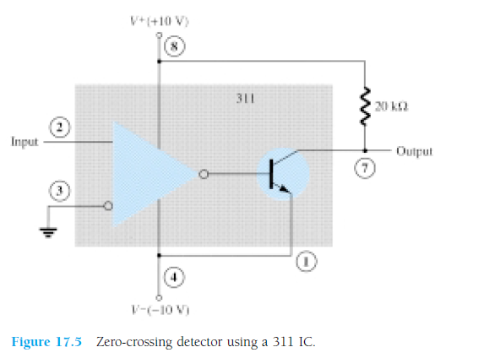
When the input is any positive voltage, the output is low, while any negative voltage will result in the output going to a high voltage level.

Slide 7
311 comparator with strobing
Figure 17.6 shows how a 311 comparator can be used with strobing. In this example,
the output will go high when the input goes above the reference level—but only if the TTL strobe input is off (or 0 V).
If the TTL strobe input goes high, it drives the 311 strobe input at pin 6 low, causing the output to remain in the off state (with output high) regardless of the input signal.
In effect, the output remains high unless strobed. If strobed, the output then acts normally, switching from high to low depending on the input signal level.
In operation, the comparator output will respond to the input signal only during the time the strobe signal allows such operation.

Slide 8
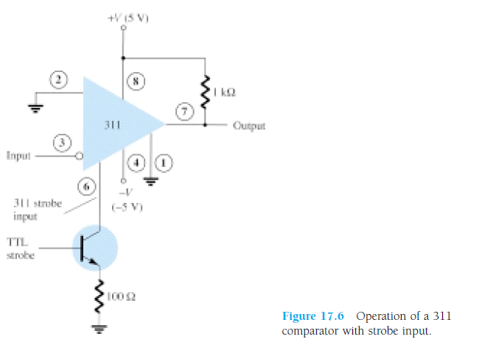

Slide 9
311 comparator output driving a relay.
Figure 17.7 shows the comparator output driving a relay.
When the input goes below 0 V, driving the output low, the relay is activated, closing the normally open (N.O.) contacts at that time.
These contacts can then be connected to operate a large variety of devices.
For example, a buzzer or bell wired to the contacts can be driven on whenever the input voltage drops below 0 V. As long as the voltage is present at the input terminal, the buzzer will remain off.

Slide 10
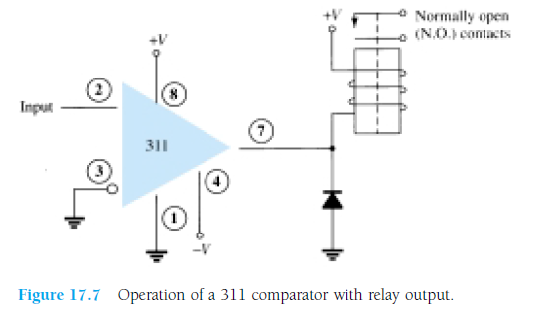

Slide 11
339 COMPARATOR
The 339 IC is a quad comparator containing four independent voltage comparator circuits connected to external pins as shown in Fig. 17.8.
Each comparator has inverting and noninverting inputs and a single output. The supply voltage applied to a pair of pins powers all four comparators.
Even if one wishes to use one comparator, all four will be drawing power.

Slide 12
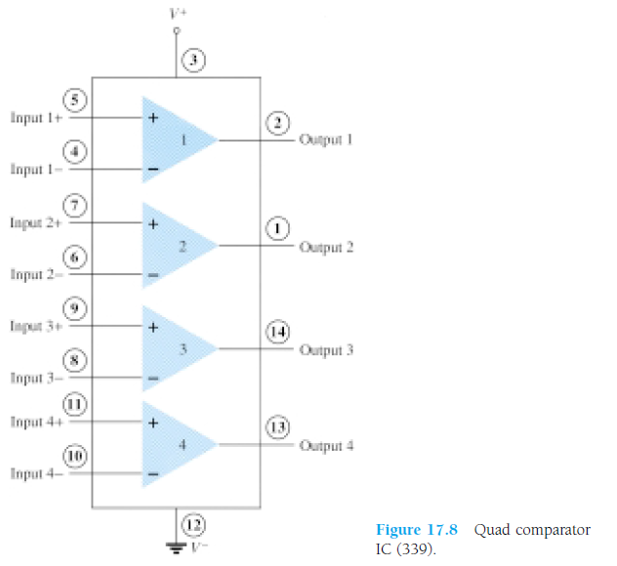

Slide 13
339 COMPARATOR
To see how these comparator circuits can be used, Fig. 17.9 shows one of the 339 comparator circuits connected as a zero-crossing detector.
Whenever the input signal goes above 0 V, the output switches to V+.
The input switches to V- only when the input goes below 0 V.
A reference level other than 0 V can also be used, and either input terminal could be used as the reference, the other terminal then being connected to the input signal.
The operation of one of the comparator circuits is described next.

Slide 14
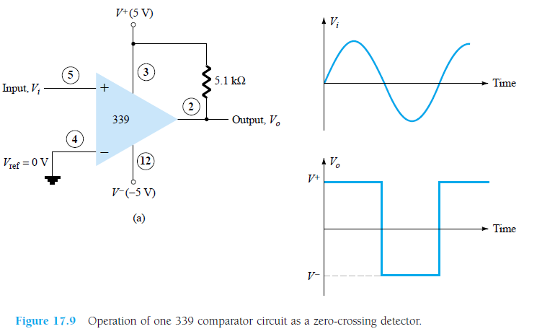

Slide 15
The differential input voltage (difference voltage across input terminals) going positive drives the output transistor off (open circuit),
while a negative differential input voltage drives the output transistor on—the output then at the supply low level.
If the negative input is set at a reference level Vref, the positive input goes above Vref and results in a positive differential input with output driven to the open-circuit state.
When the noninverting input goes below Vref, resulting in a negative differential input, the output will be driven to V-.
If the positive input is set at the reference level, the inverting input going below Vref results in the output open circuit while the inverting input going above Vref results in the output at V-.
This operation is summarized in Fig. 17.10.

Slide 17
Since the output of one of these comparator circuits is from an open-circuit collector, applications in which the outputs from more than one circuit can be wire-ORed are possible.
Figure 17.11 shows two comparator circuits connected with common output and also with common input.
Comparator 1 has a +5 V reference voltage put connected to the noninverting input.
The output will be driven low by comparator 1 when the input signal goes above +5 V. (Vin > +5)
Comparator 2 has a reference voltage of +1 V connected to the inverting input. The output of comparator 2 will be driven low when the input signal goes below +1 V. (Vin<1)
In total, the output will go low whenever the input is below +1 V or above +5 V, as shown in Fig. 17.11, the overall operation being that of a voltage window detector.
The high output indicates that the input is within a voltage window of +1 to +5 V (these values being set by the reference voltage levels used).

Slide 18
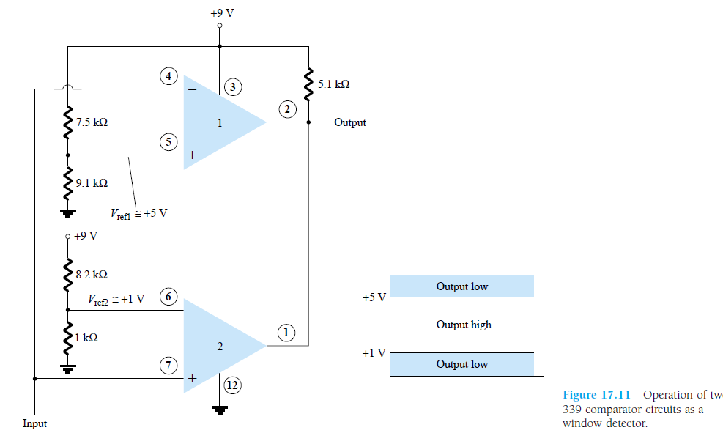
WINDOW DECTOR

Slide 19
DIGITAL–ANALOG CONVERTERS
Many voltages and currents in electronics vary continuously over some range of values.
In digital circuitry the signals are at either one of two levels, representing the binary values of 1 or zero. An analog–digital converter (ADC) obtains a digital value representing an input analog voltage.
while a digital–analog converter (DAC) changes a digital value back into an analog voltage.

Slide 20
Digital-to-Analog Conversion LADDER NETWORK CONVERSION
One popular scheme uses a network of resistors, called a ladder network.
A ladder network accepts inputs of binary values at, typically, 0 V or Vref and provides an output voltage proportional to the binary input value.
Figure 17.12a shows a ladder network with four input voltages, representing 4 bits of digital data and a dc voltage output.
The output voltage is proportional to the digital input value as given by the relation

Slide 21
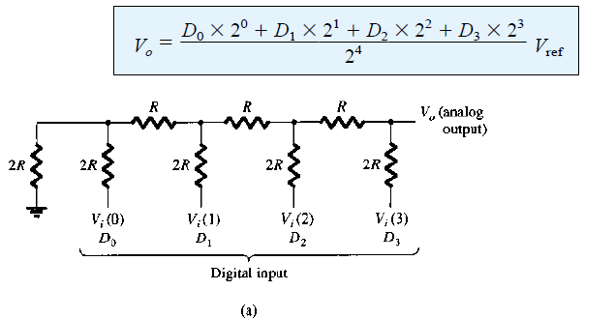

Slide 23
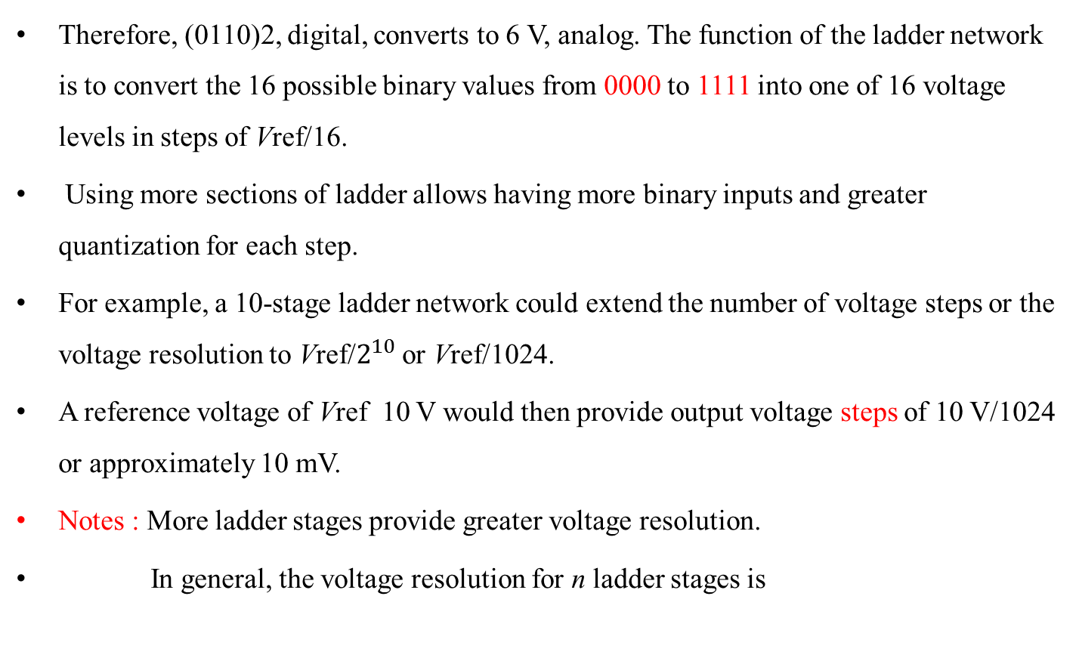
Ladder network
Therefore, (0110)2, digital, converts to 6 V, analog. The function of the ladder network is to convert the 16 possible binary values from 0000 to 1111 into one of 16 voltage levels in steps of Vref/16.
Using more sections of ladder allows having more binary inputs and greater quantization for each step.
For example, a 10-stage ladder network could extend the number of voltage steps or the voltage resolution to Vref/$2^{10}$ or Vref/1024.
A reference voltage of Vref 10 V would then provide output voltage steps of 10 V/1024 or approximately 10 mV.
Notes : More ladder stages provide greater voltage resolution.
In general, the voltage resolution for n ladder stages is

Slide 24
ladder network
Figure 17.13 shows a block diagram of a typical DAC using a ladder network.
The ladder network, referred in the diagram as an R-2R ladder, is sandwiched between the reference current supply and current switches connected to each binary input, the resulting output current proportional to the input binary value.
The binary input turns on selected legs of the ladder, the output current being a weighted summing of the reference current.
Connecting the output current through a resistor will produce an analog voltage, if desired.

Slide 25
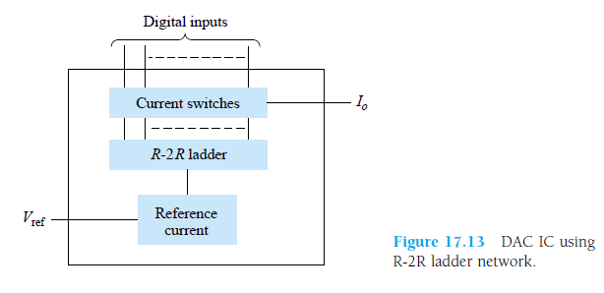

Slide 26
Analog-to-Digital Conversion DUAL-SLOPE CONVERSION
A popular method for converting an analog voltage into a digital value is the dual slope
method.
Figure 17.14a shows a block diagram of the basic dual-slope converter.
The analog voltage to be converted is applied through an electronic switch to an integrator or ramp-generator circuit (essentially a constant current charging a capacitor
to produce a linear ramp voltage).
The digital output is obtained from a counter operated during both positive and negative slope intervals of the integrator.
The method of conversion proceeds as follows. For a fixed time interval (usually the full count range of the counter), the analog voltage connected to the integrator raises the voltage at the comparator input to some positive level.

Slide 27
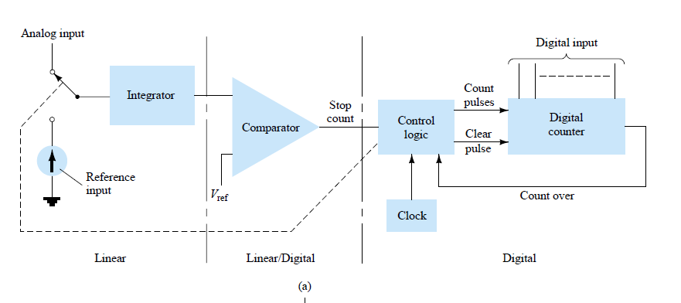

Slide 28
Figure 17.14b shows that at the end of the fixed time interval the voltage from the integrator is greater for the larger input voltage.
At the end of the fixed count interval, the count is set to zero and the electronic switch connects the integrator to a reference or fixed input voltage
The integrator output (or capacitor input) then decreases at a fixed rate.
The counter advances during this time, while the integrator’s output decreases at a fixed rate until it drops below the comparator reference voltage, at which time the control logic receives a signal (the comparator output) to stop the count. The digital value stored in the counter is then the digital output of the converter

Slide 29
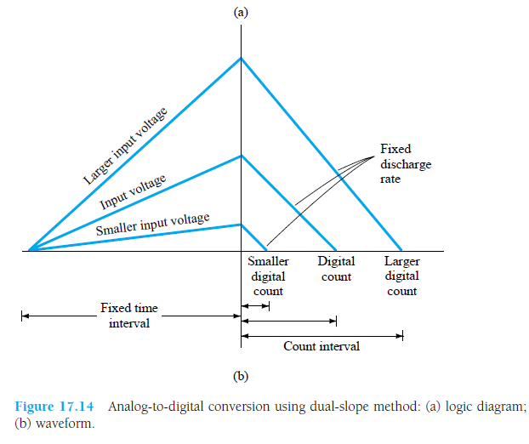

Slide 30
LADDER-NETWORK CONVERSION
Another popular method of analog-to-digital conversion uses a ladder network along with counter and comparator circuits (see Fig. 17.15).
A digital counter advances from a zero count while a ladder network driven by the counter outputs a staircase voltage, as shown in Fig. 17.15b, which increases one voltage increment for each count step.
A comparator circuit, receiving both staircase voltage and analog input voltage, provides a signal to stop the count when the staircase voltage rises above the input voltage.
The counter value at that time is the digital output.

Slide 31
The amount of voltage change stepped by the staircase signal depends on the number of count bits used.
This would result in a conversion resolution of 2.4 mV. The clock rate of the counter would affect the time required to A 12-stage counter operating a 12-stage ladder network using a reference voltage of 10 V would step each count by a voltage of carry out a conversion. A clock rate of 1 MHz operating a 12-stage counter would need a maximum conversion time of

Slide 32
